Slide 1


Tubes Cicle
Ghifari Naufal Rahman
Testing Cicle
QA-15

Slide 2
Tubes Cicle
Ghifari Naufal Rahman
Overview
Performance Testing
API Testing
Web Testing
Testing ini berisi atas:
Test API Delete 1 test
Test API GET 2 test
Test API PATCH 2 test
Test API POST 2 test
Tools: Katalon dan Postman
Web Testing meliputi:
Board Test
Blast Test
Group Chat Test
Tools: Intelij (Java,Gherkin)
Framework : Selenium dan Cucumber
Performance Testing berupa load testing chat group
Tools: JMeter dan extension Blazemeter

Slide 3
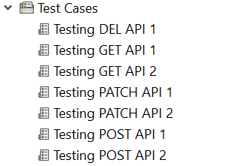
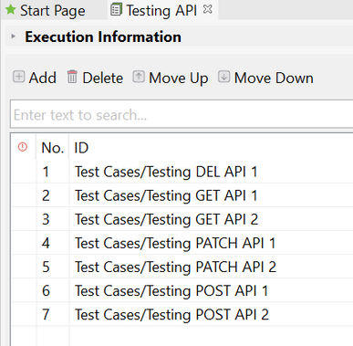
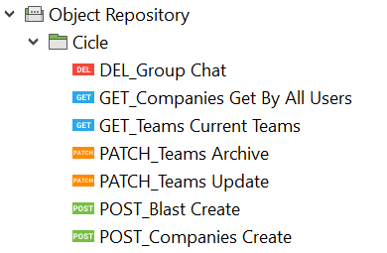
Tubes Cicle
Ghifari Naufal Rahman
1. API TESTING
Object Repository
Test Cases
Test Suites

Slide 4
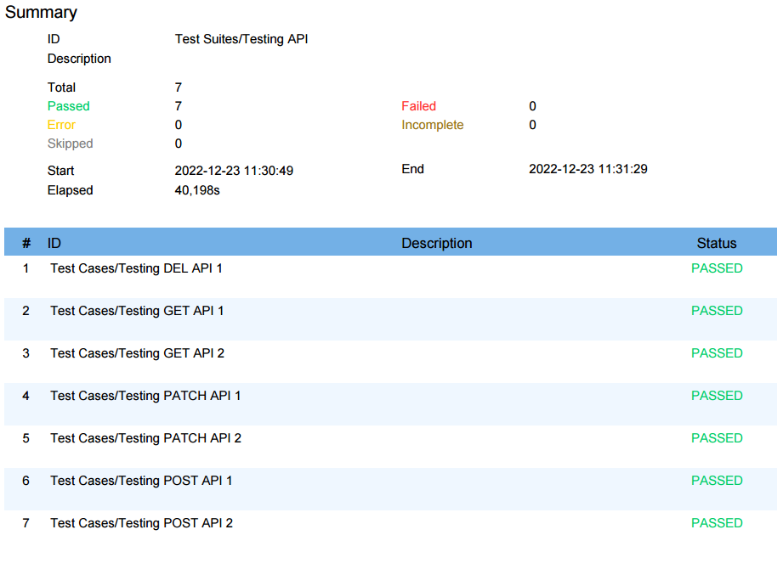
Tubes Cicle
Ghifari Naufal Rahman
API TESTING: Result

Slide 5
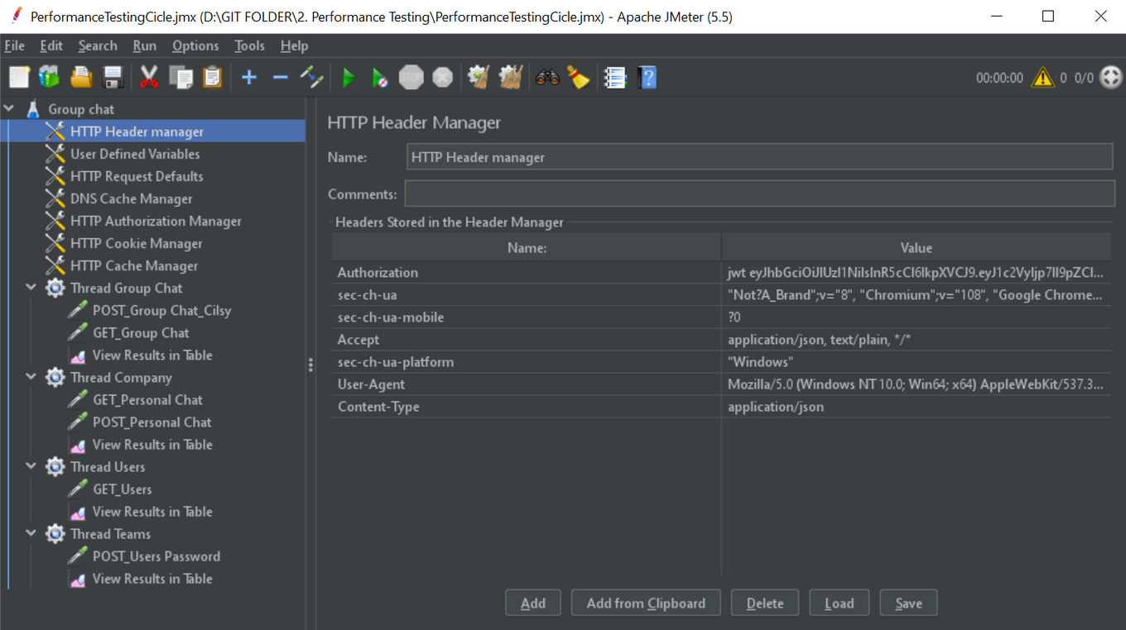
Tubes Cicle
Ghifari Naufal Rahman
2. Performance Testing

Slide 6
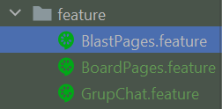
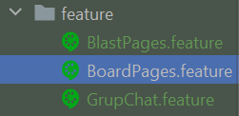
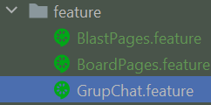
Tubes Cicle
Ghifari Naufal Rahman
3. Web Testing
Blast Page
Board Page
Group Chat
Testing ini berisi atas:
Positive-Open-Menu-Blast
Positive-Create-Blast-With-Field-Title-And-Description
Positive-Create-Blast-With-Empty-Description
Positive-Archive-Blast
Negative-Create-Blast-With-Empty-Title-And-Description
Negative-Create-Blast-With-Empty-Title
Testing ini berisi atas:
Positive-Add-List
Positive-Add-Card
Positive-Set-Complete-List-Card
Positive-Open-Menu-Board
Negative-Add-Empty-Card
Negative-Add-Empty-Card-List
Testing ini berisi atas:
Positive-Open-Menu-GroupChat
Positive-Send-Message
Positive-Mention-Member
Positive-Upload-File
Negative-Send-Empty-Message

Slide 7
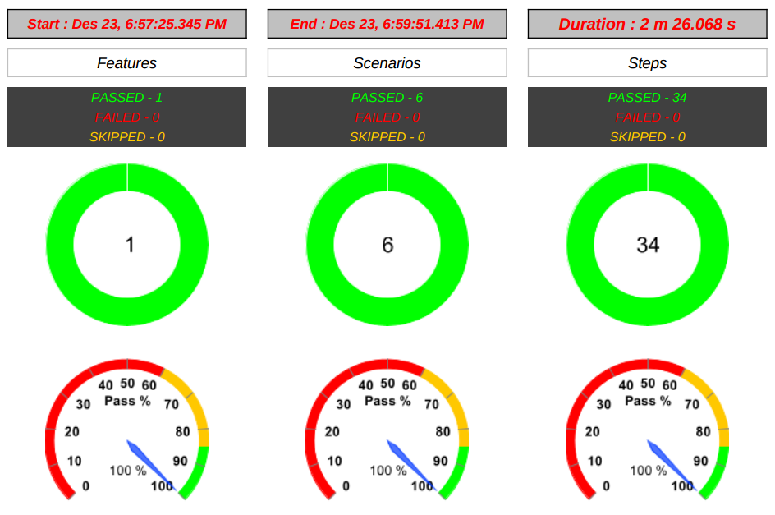
Tubes Cicle
Ghifari Naufal Rahman
Web Testing: Result Blast

Slide 8
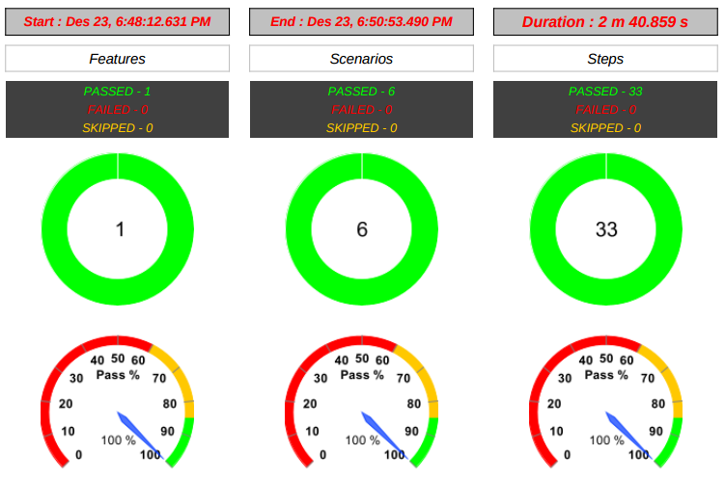
Tubes Cicle
Ghifari Naufal Rahman
Web Testing: Result Board

Slide 9
Tubes Cicle
Ghifari Naufal Rahman
Web Testing: Group Chat

Slide 10
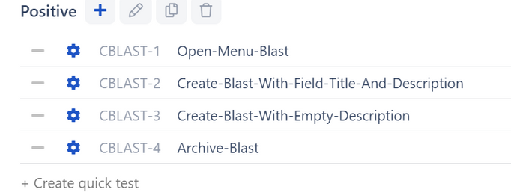
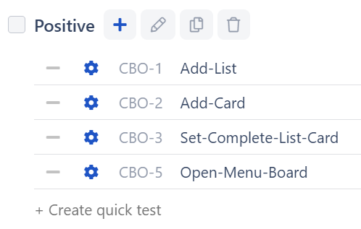
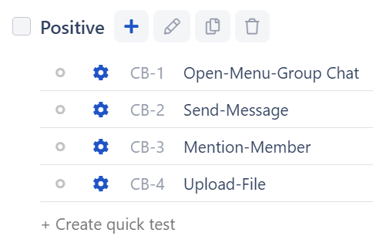
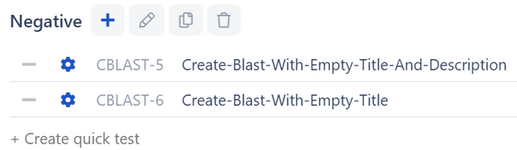
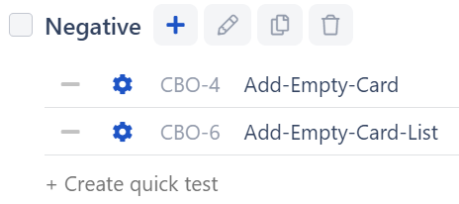
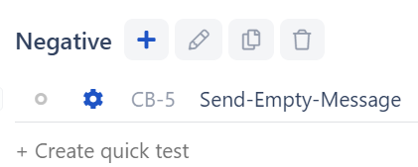
Tubes Cicle
Ghifari Naufal Rahman
4. Manual WEB Testing Qase.io
BLAST CASE
BOARD CASE
GROUP CHAT

